Slide 1
Introduction to rest api

Slide 2
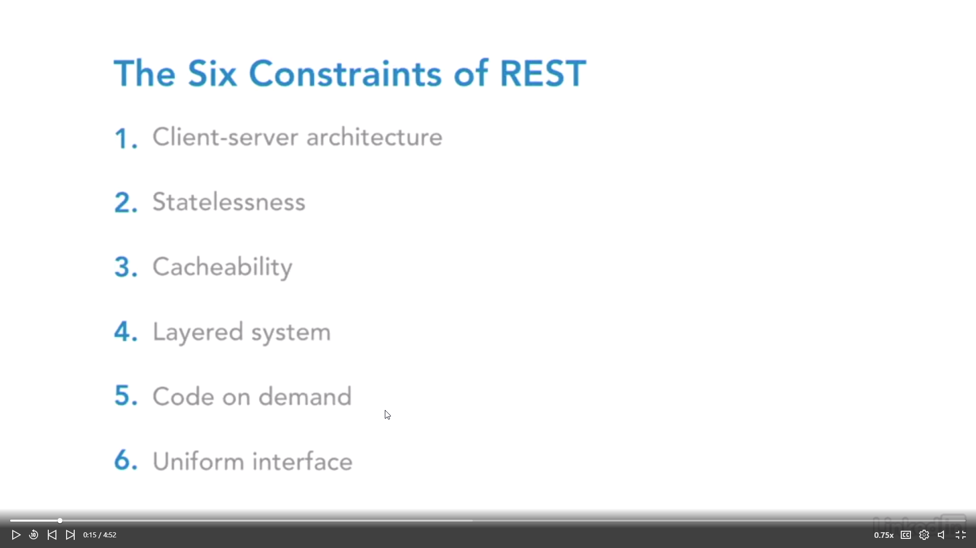
Six constraints that define REST

Slide 3
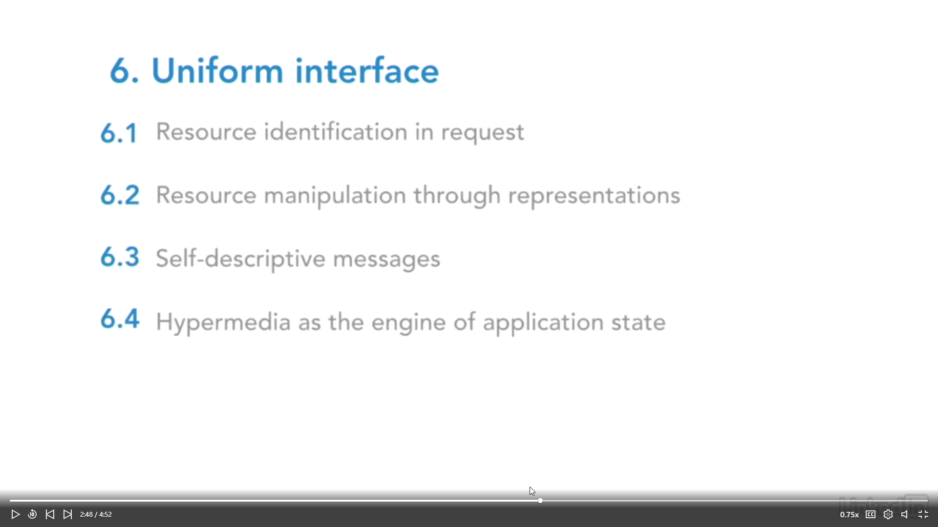
Details about constraint 6. Uniform interface

Slide 4
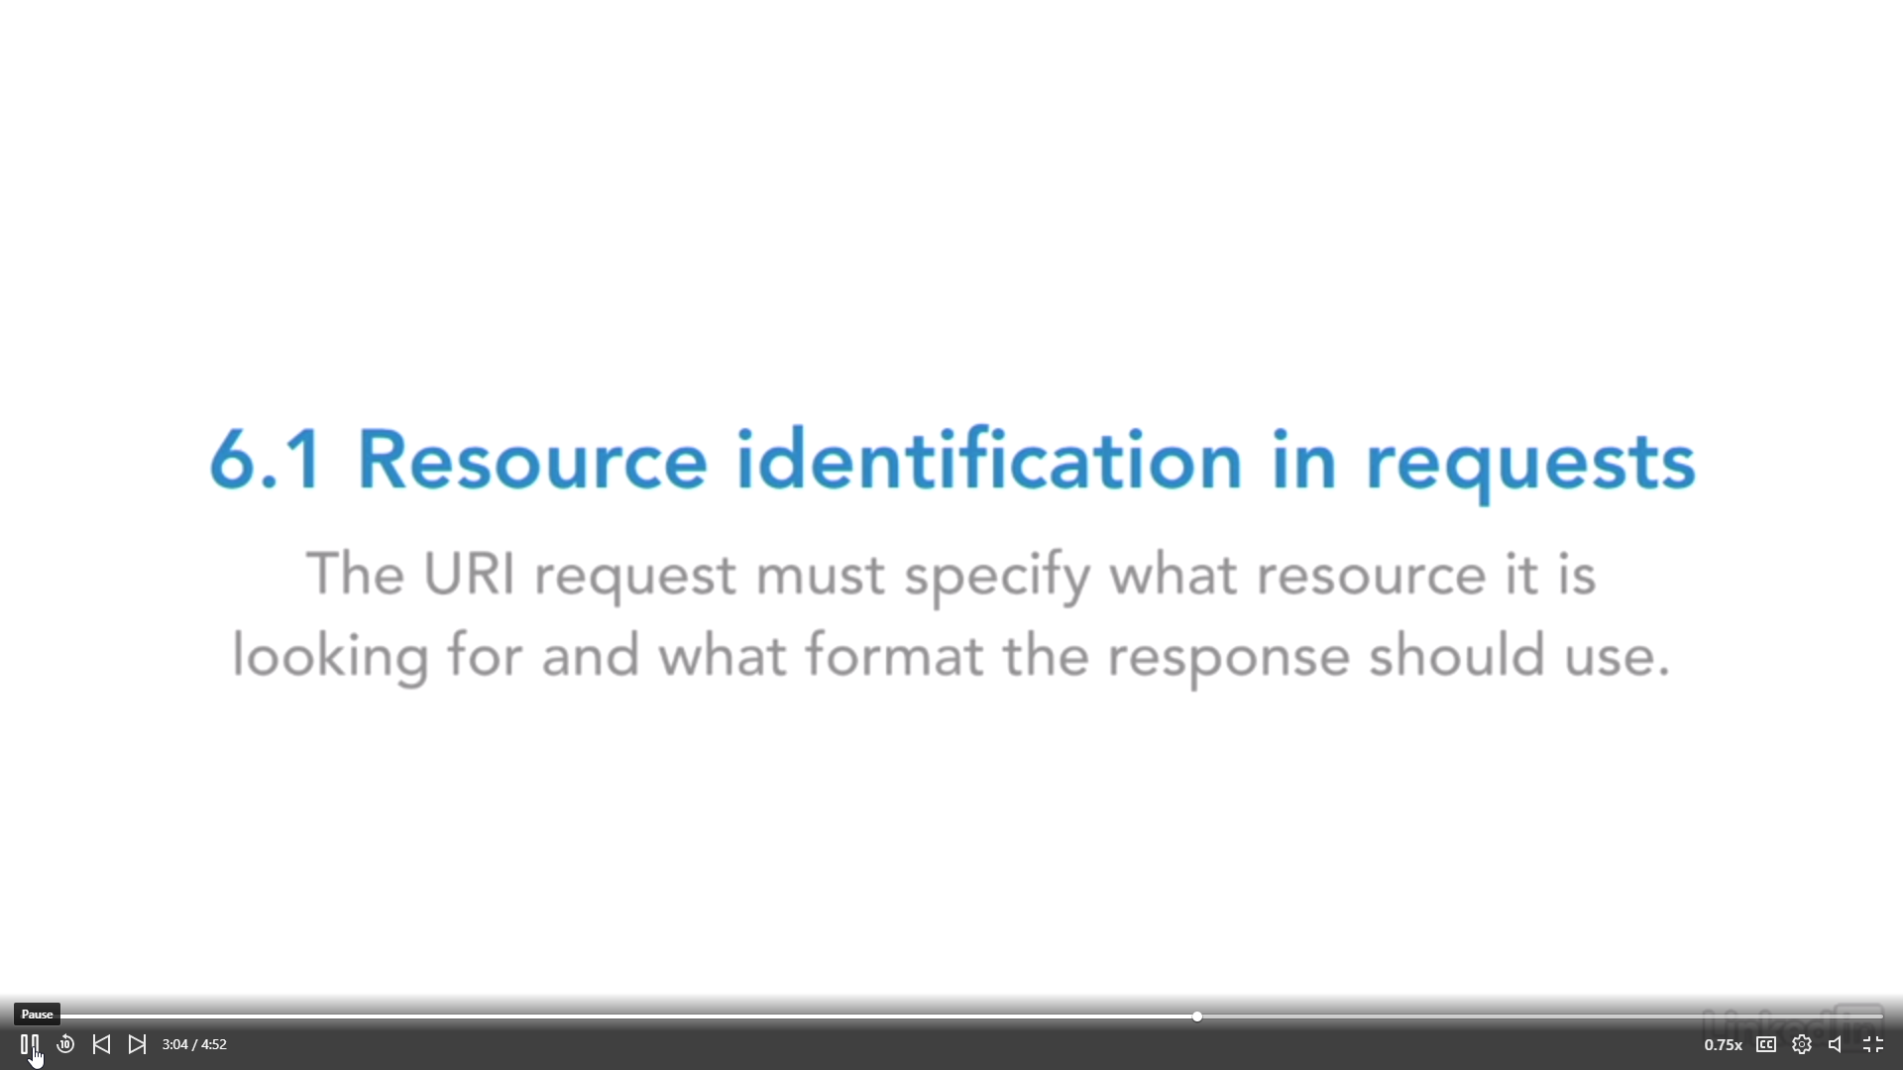
6.1 Resource identification in requests

Slide 5
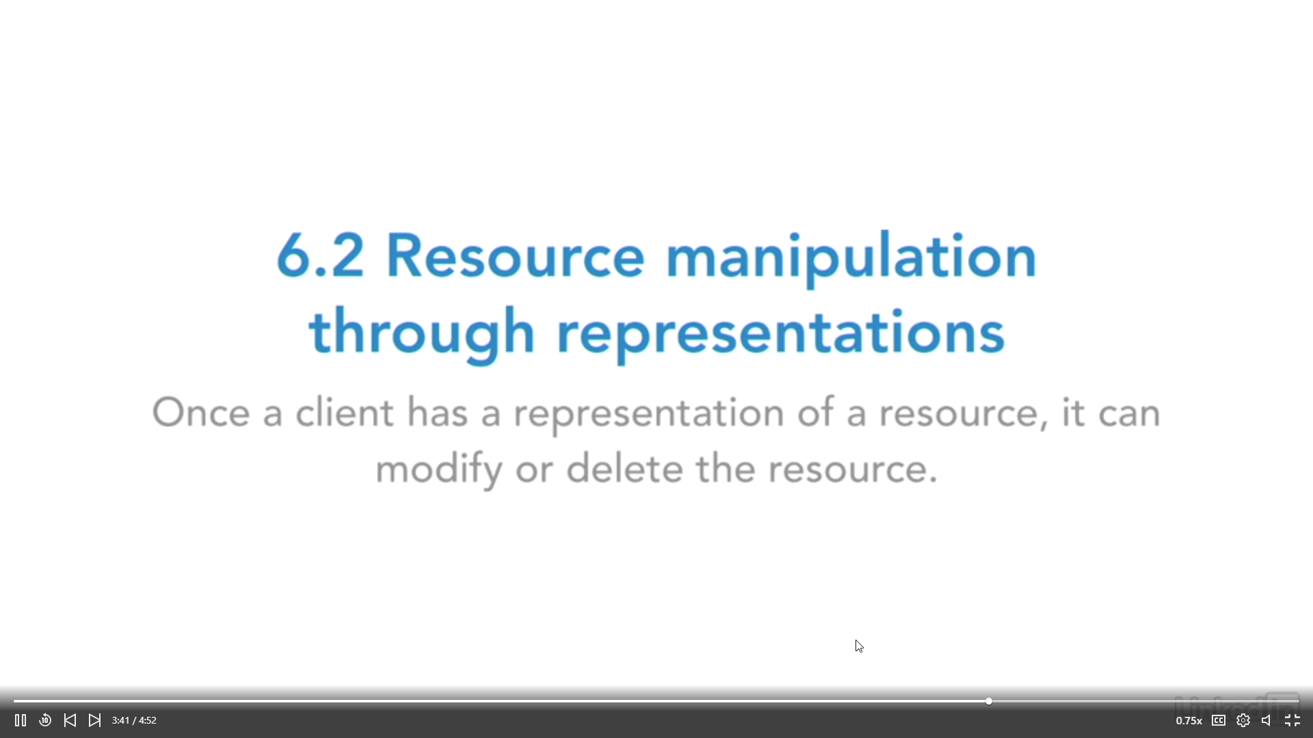
6.2 RESOURCE MANIPULATION THROUGH REPRESENTATIONS

Slide 6
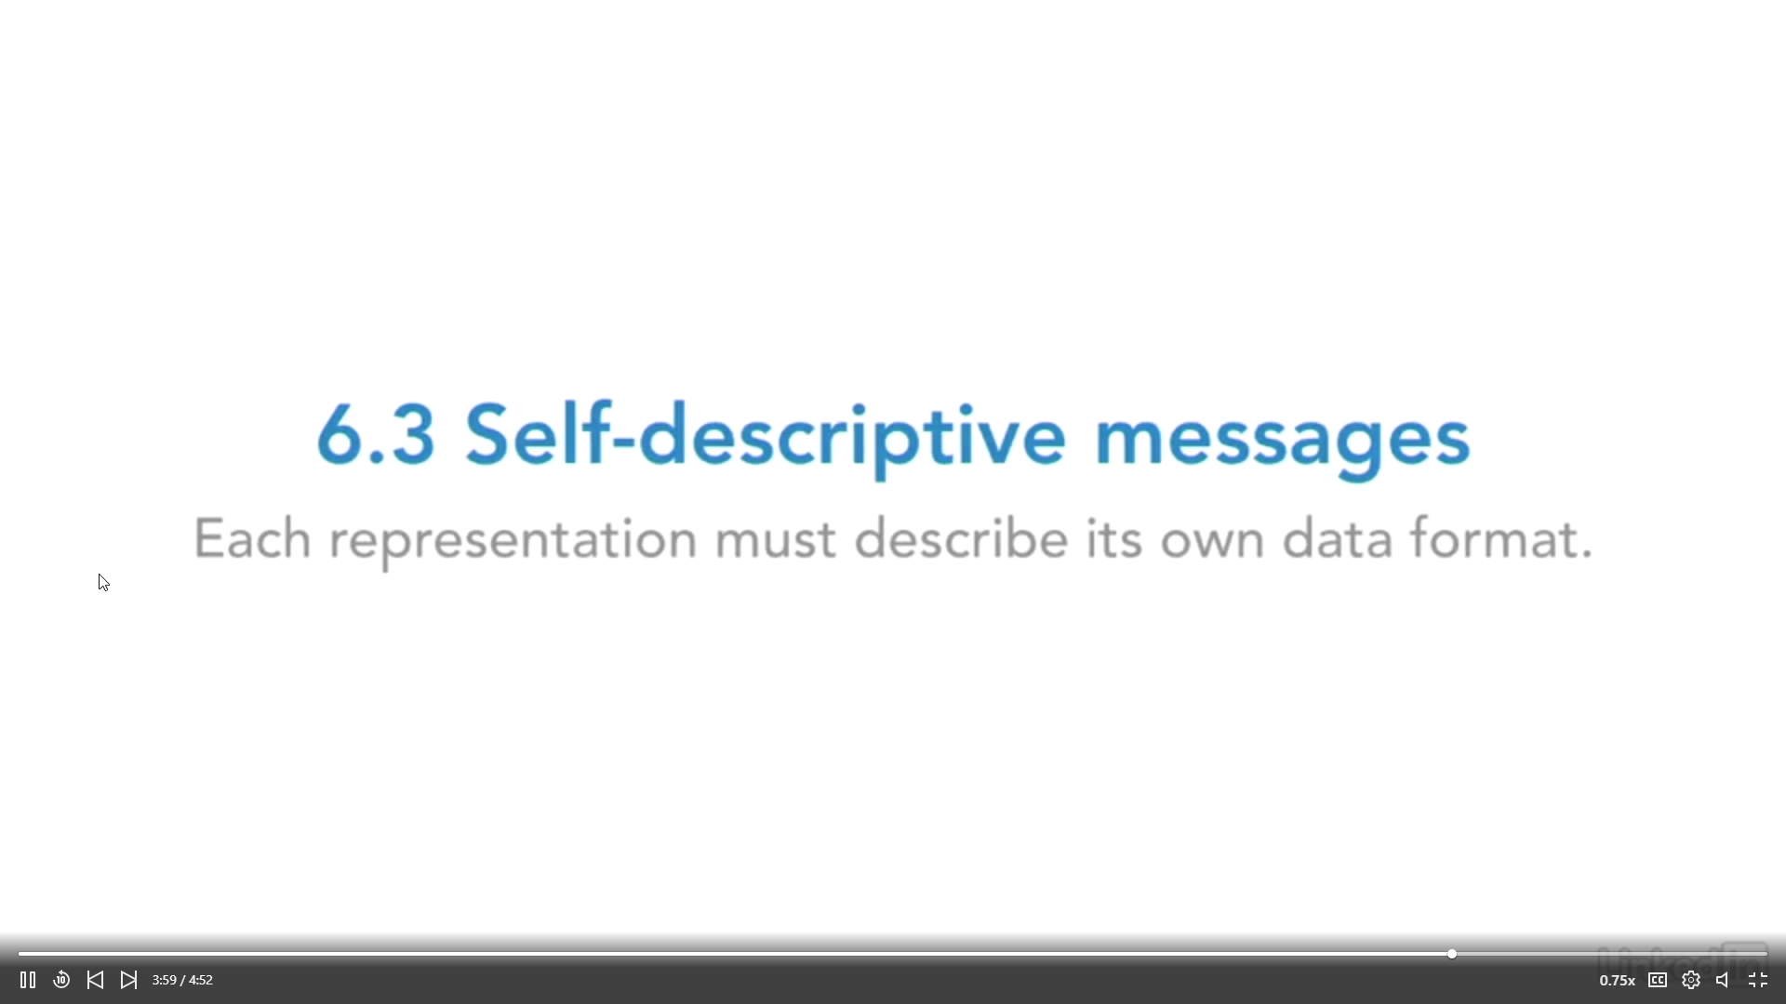
6.3 self descriptive messages

Slide 7
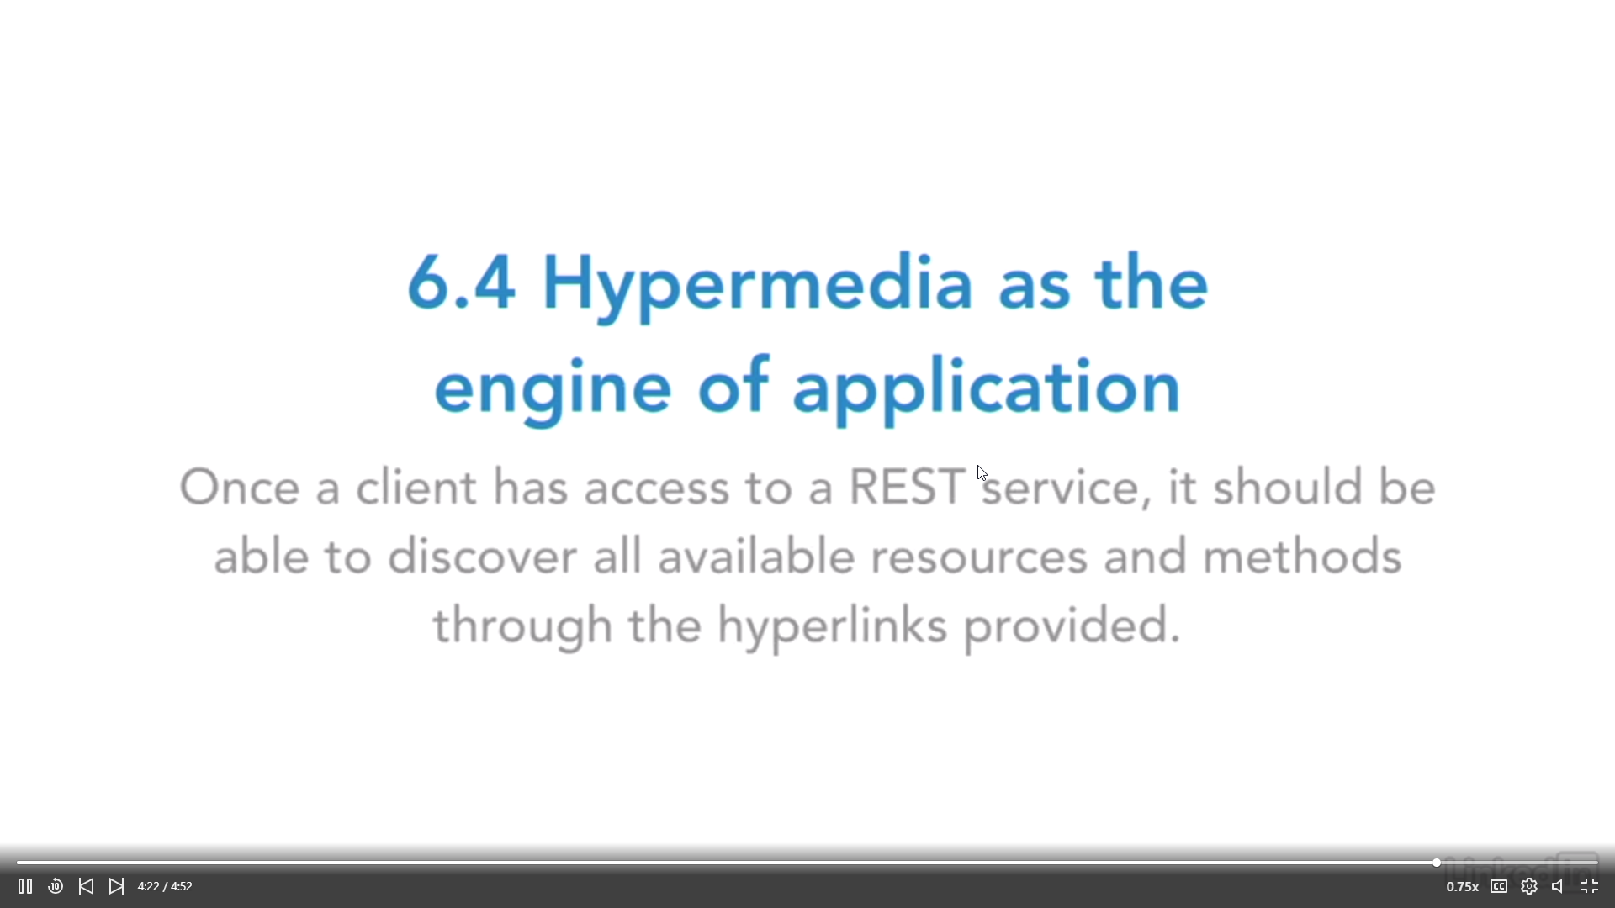
6.4 Hypermedia as the engine of application

Slide 8
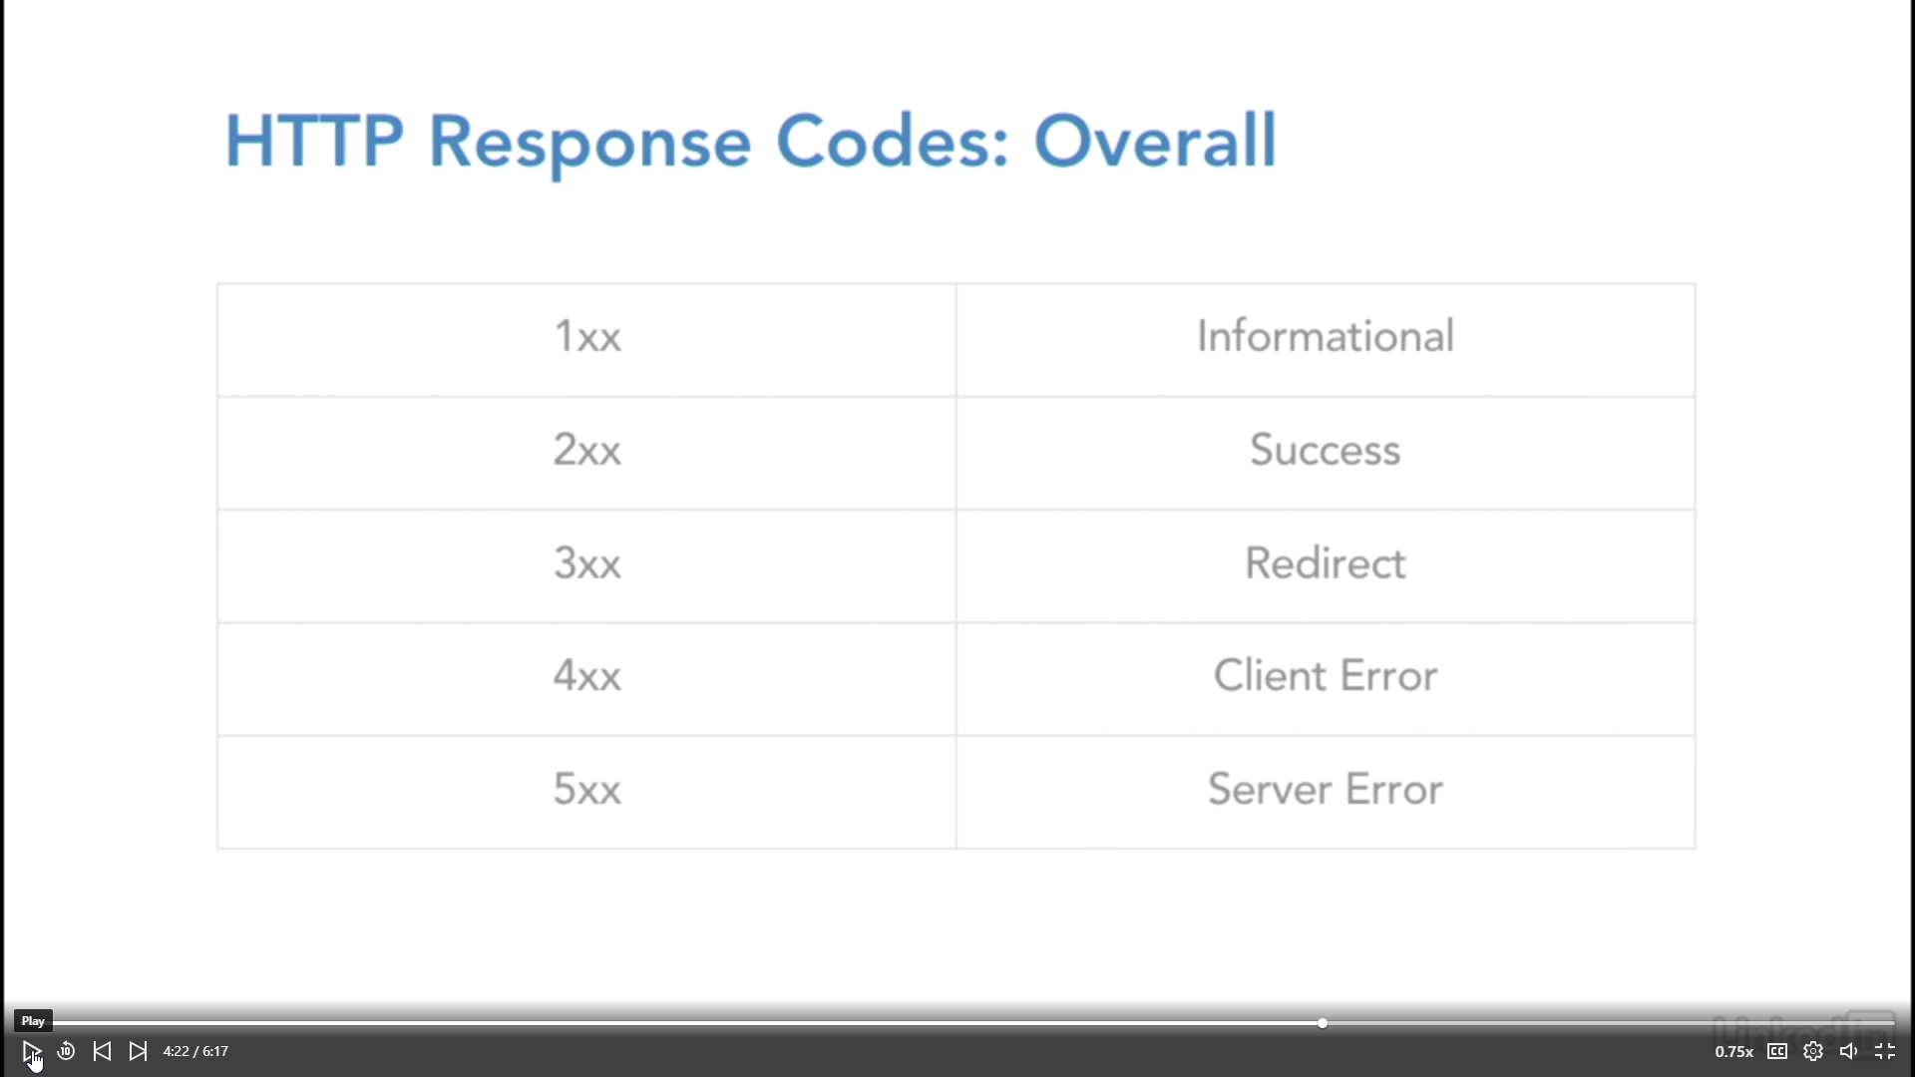
http response codes

Slide 9
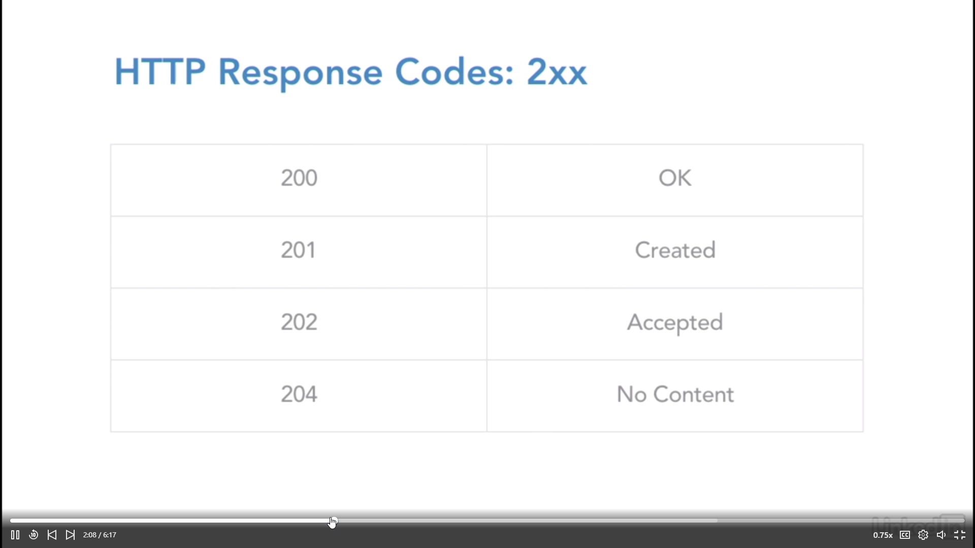
http response codes 2xx

Slide 10
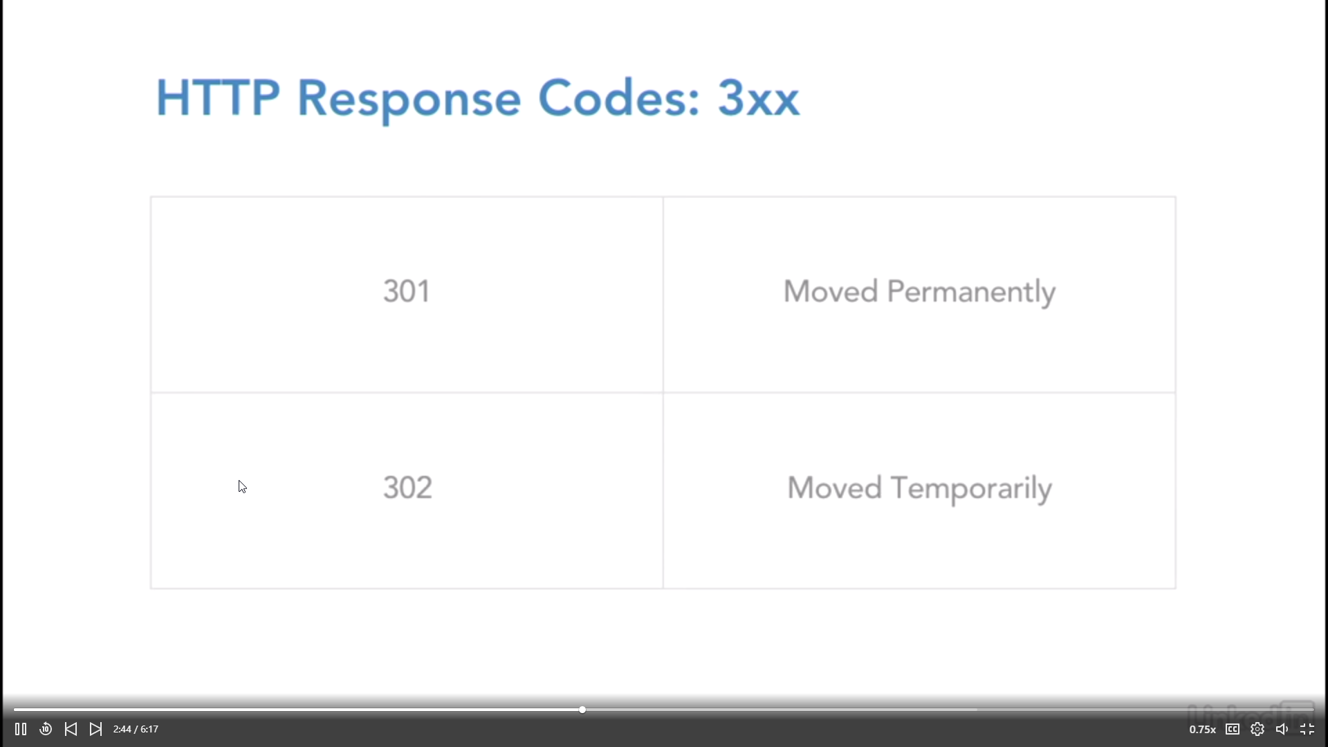
HTTP RESPONSE CODES 3XX

Slide 11
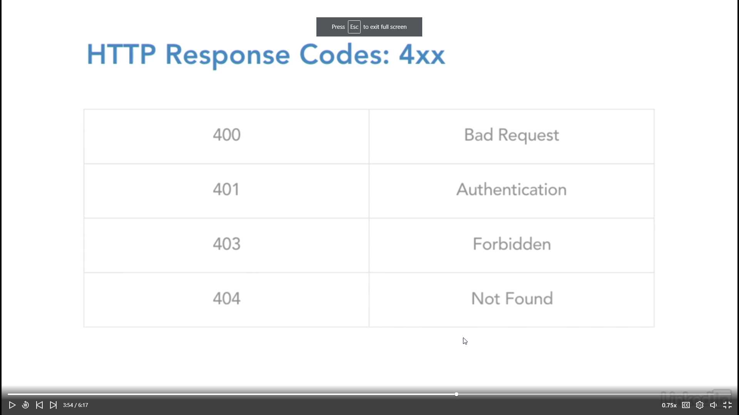
http response codes 4xx

Slide 12
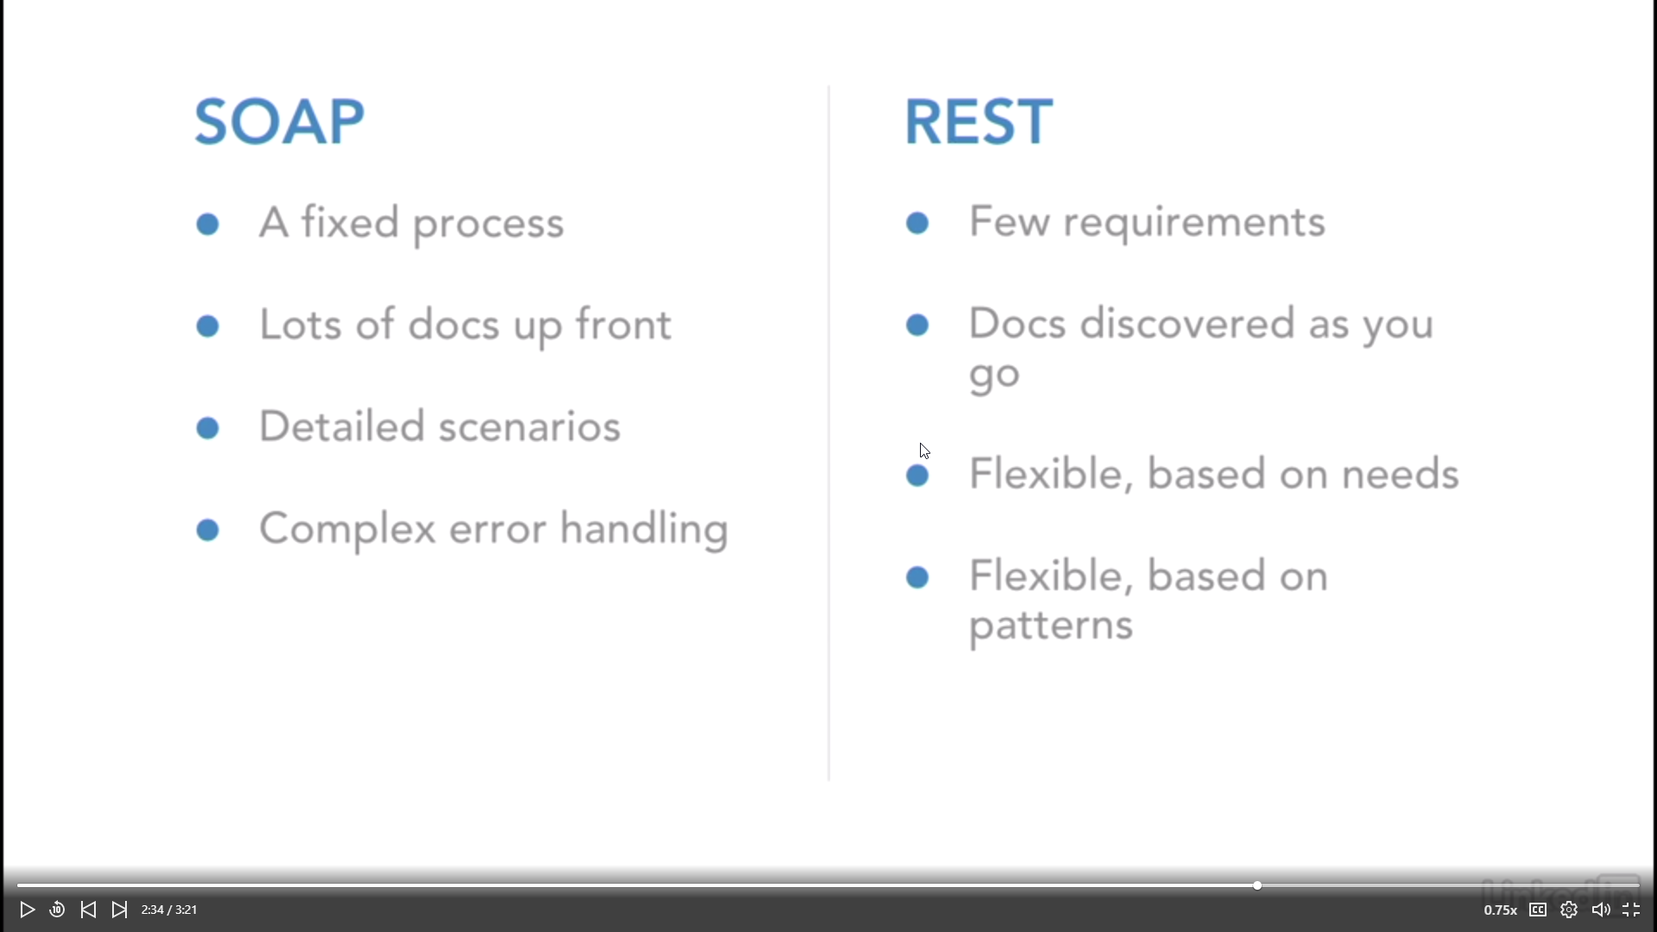
Soap vs rest

Slide 13
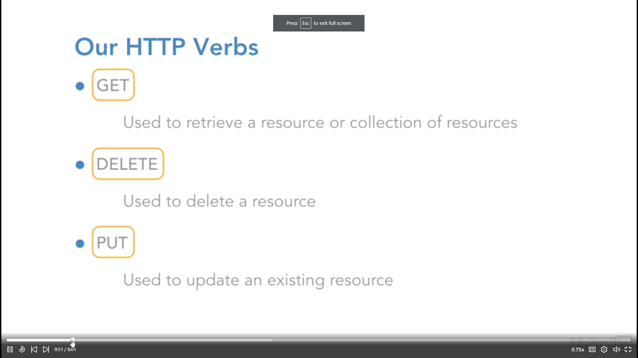
http verbs: get, delete, put

Slide 14
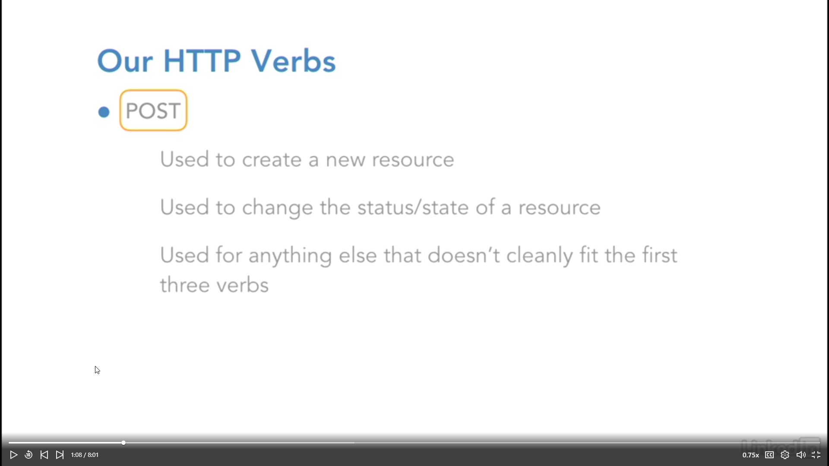
http verbs: post

Slide 15
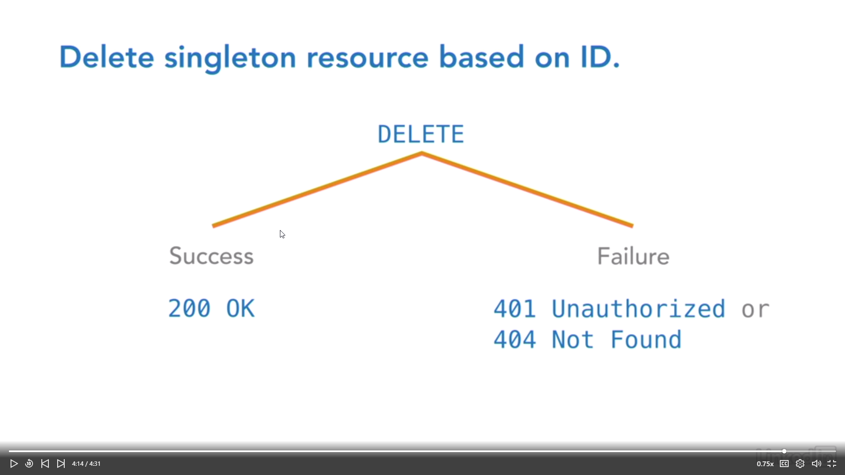
About the delete method

Slide 16
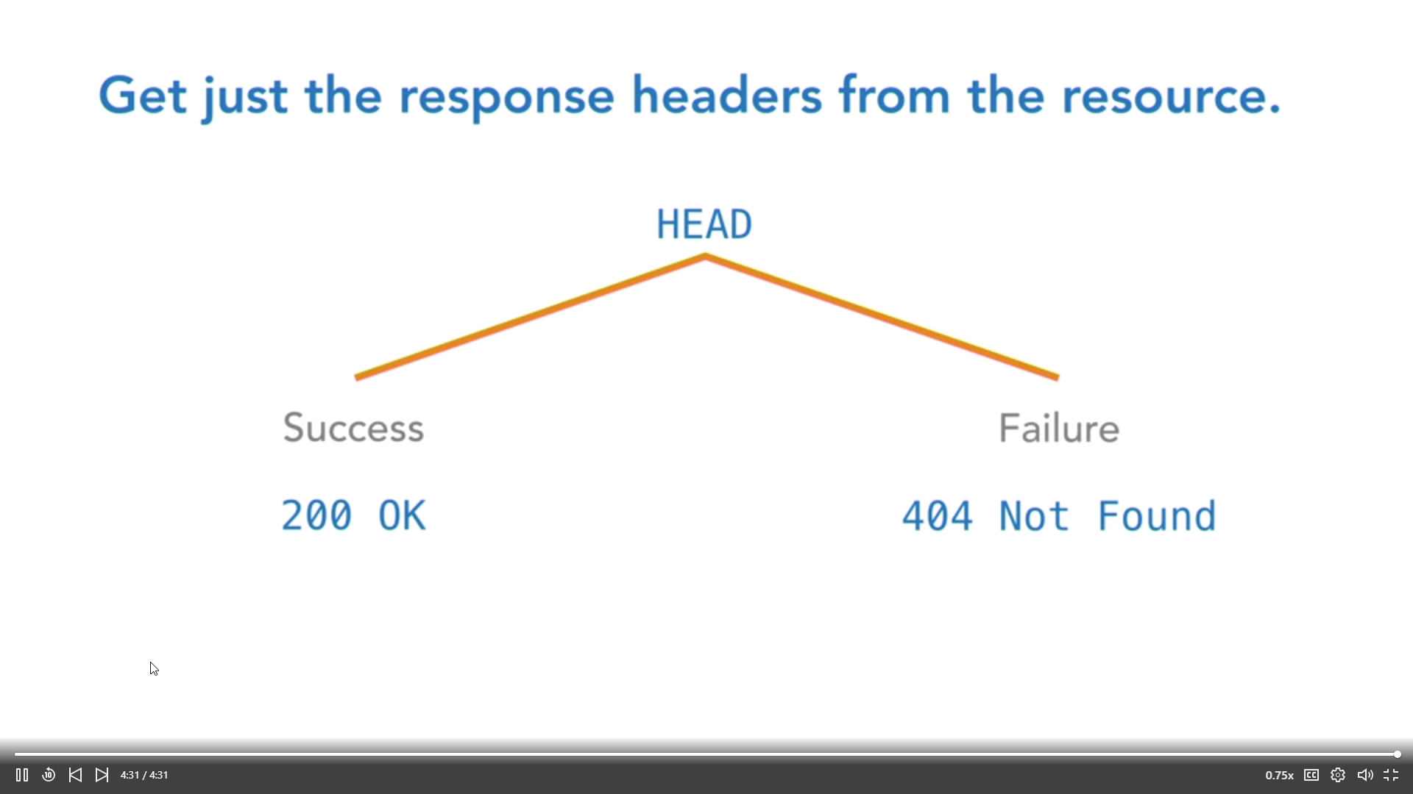
About the head method

Slide 17
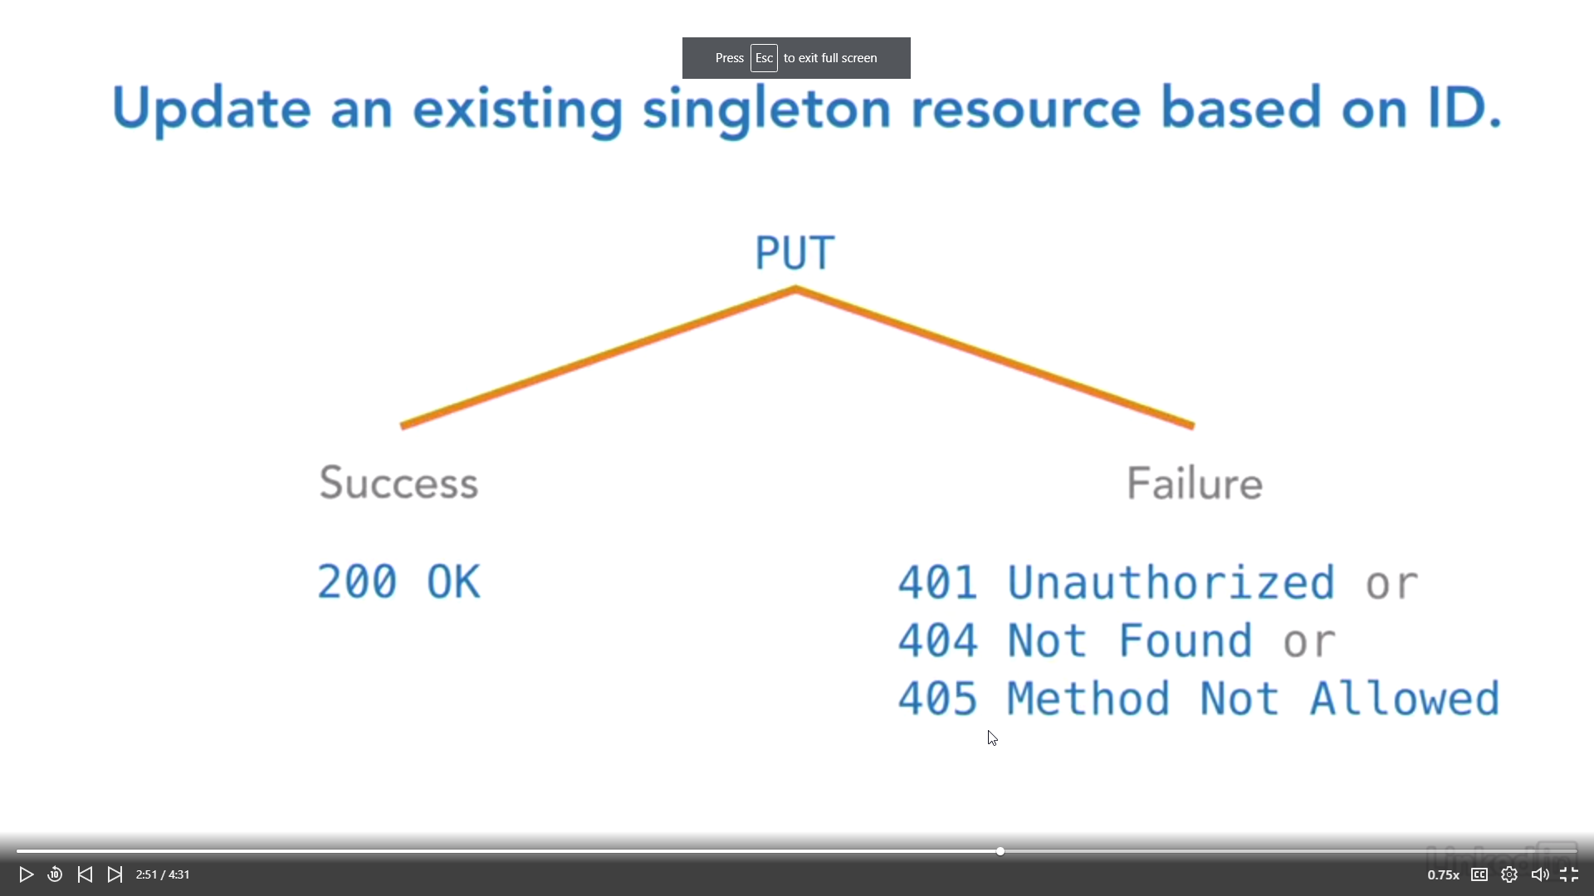
About the put method

Slide 18
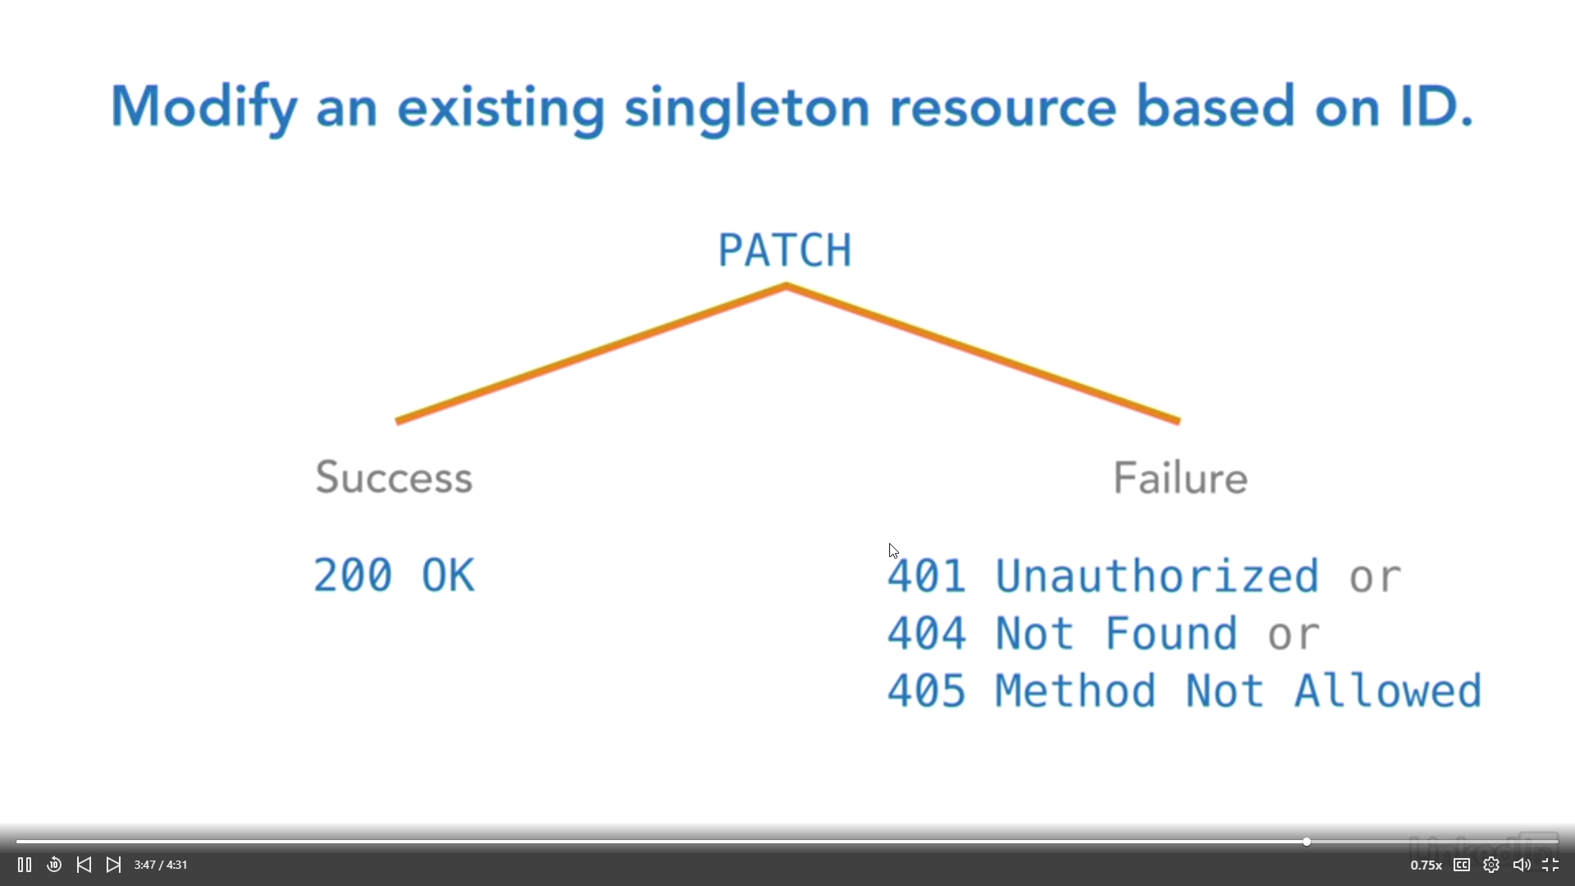
About the patch method

Slide 19
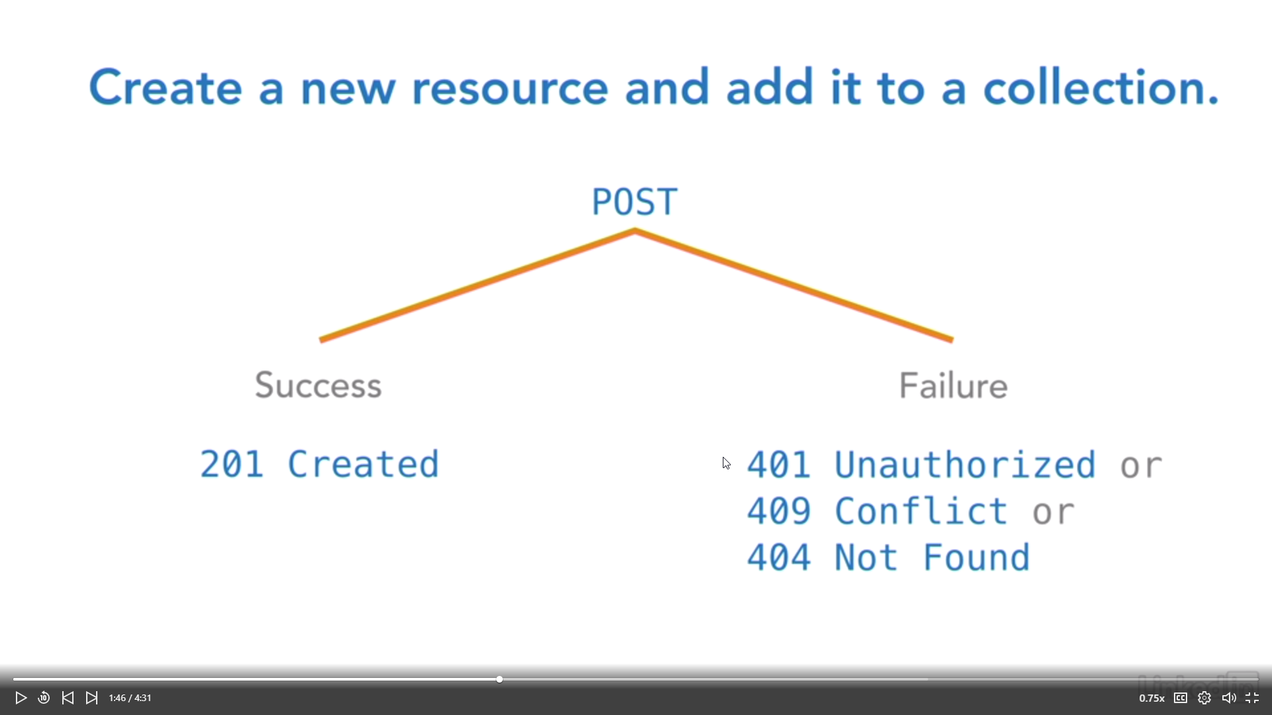
ABOUT THE POST METHOD

Slide 20
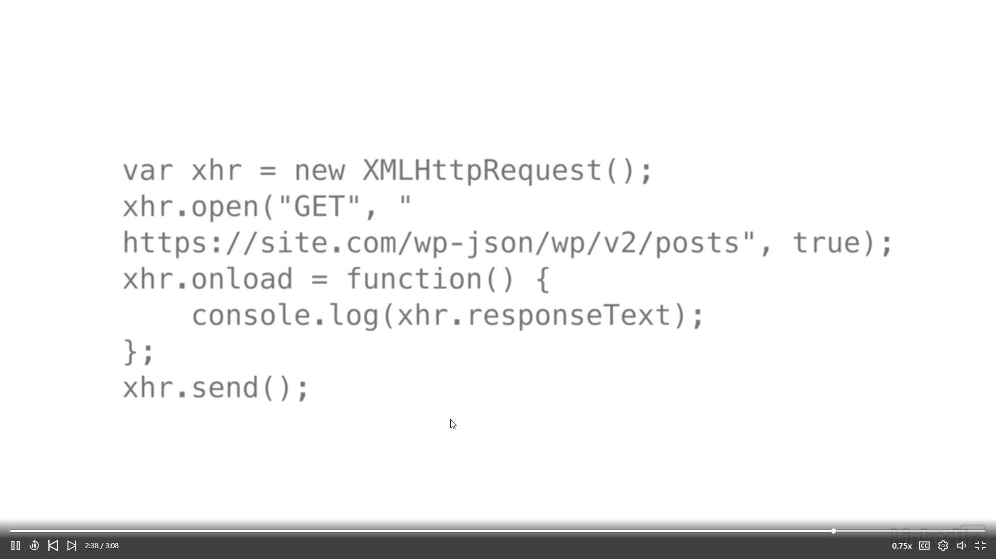
JAVASCRIPT CODE SAMPLE FOR A GET METHOD

Slide 21
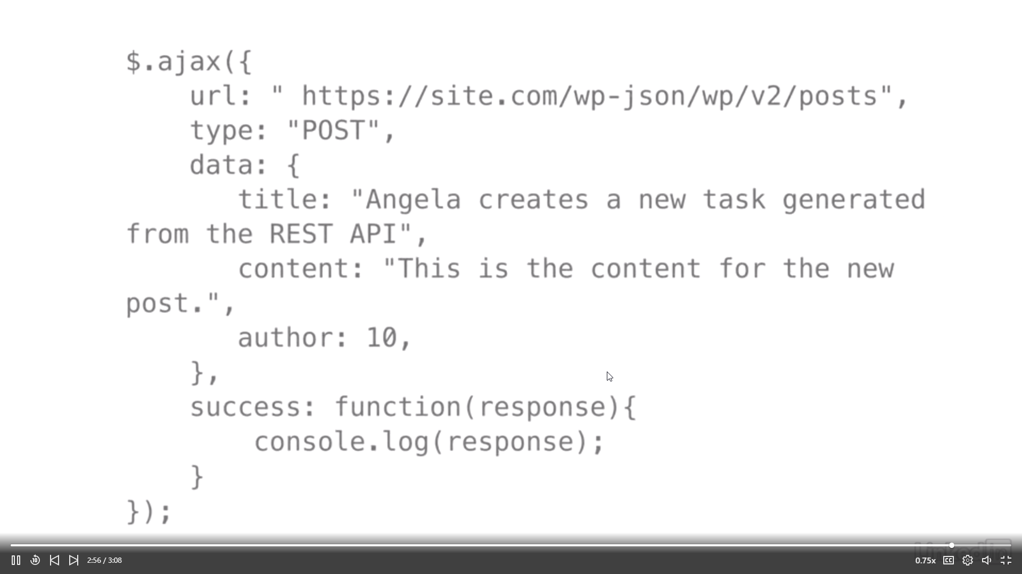
AJAX CODE SAMPLE FOR A POST METHOD

Slide 22
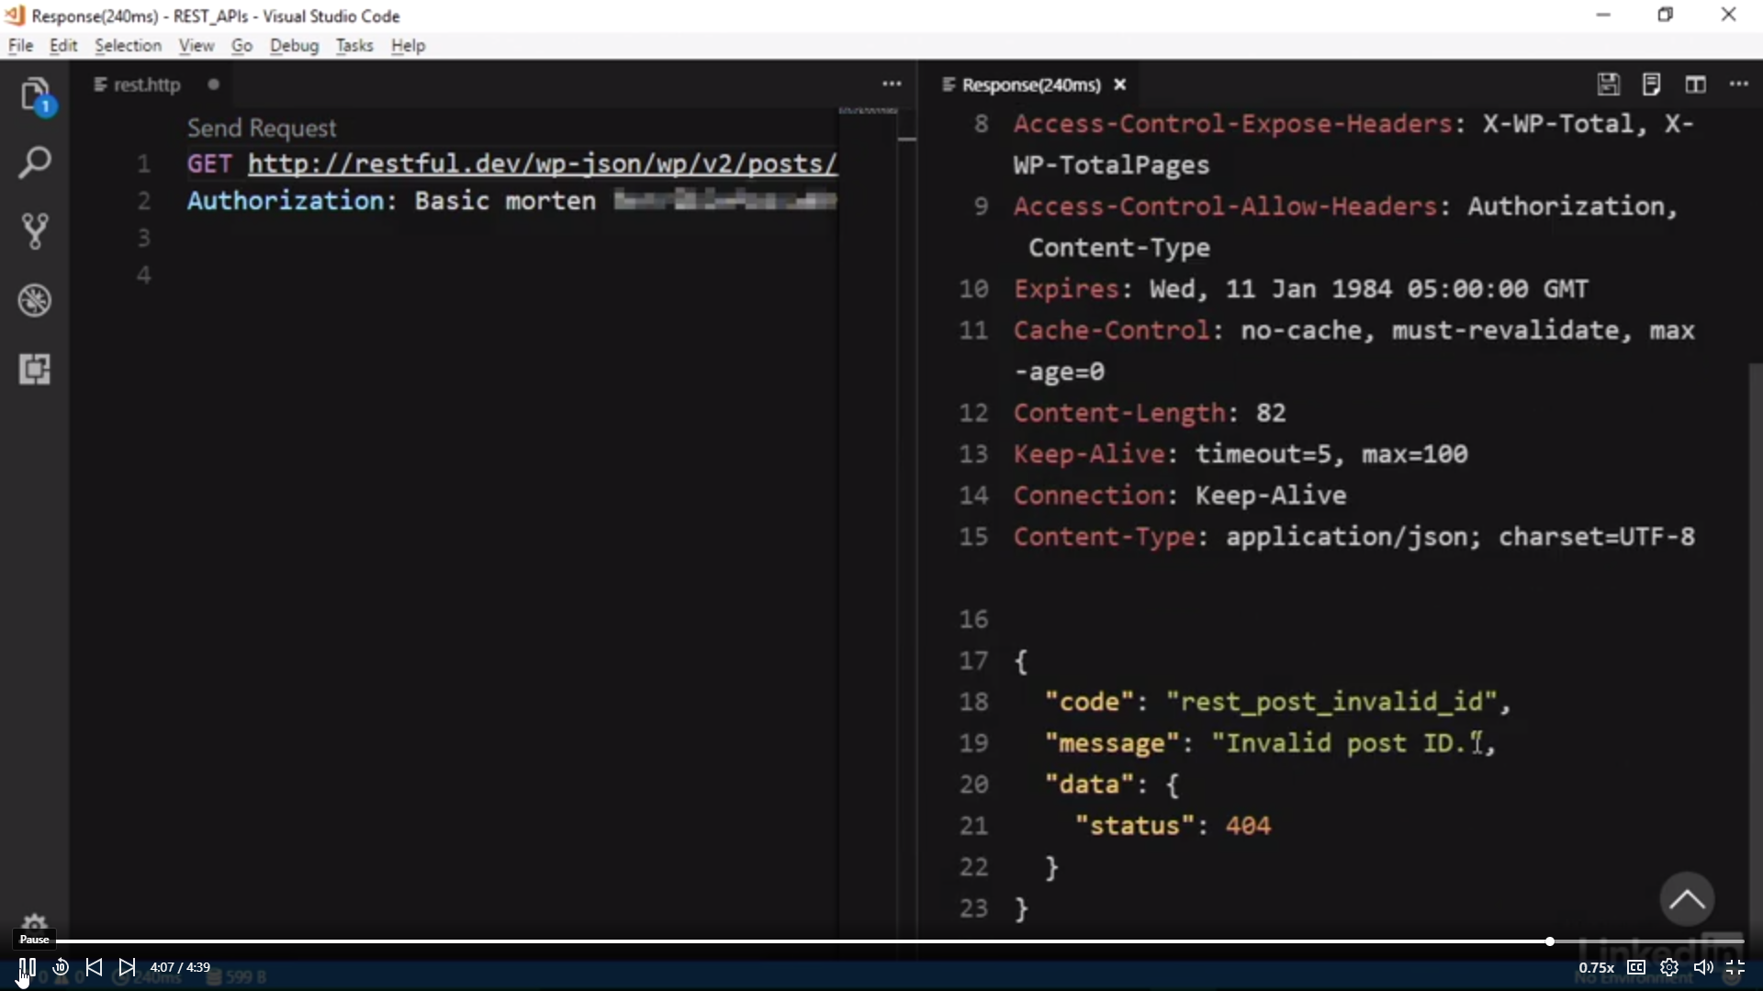
Example of get method against the WORDPRESS API

Slide 23
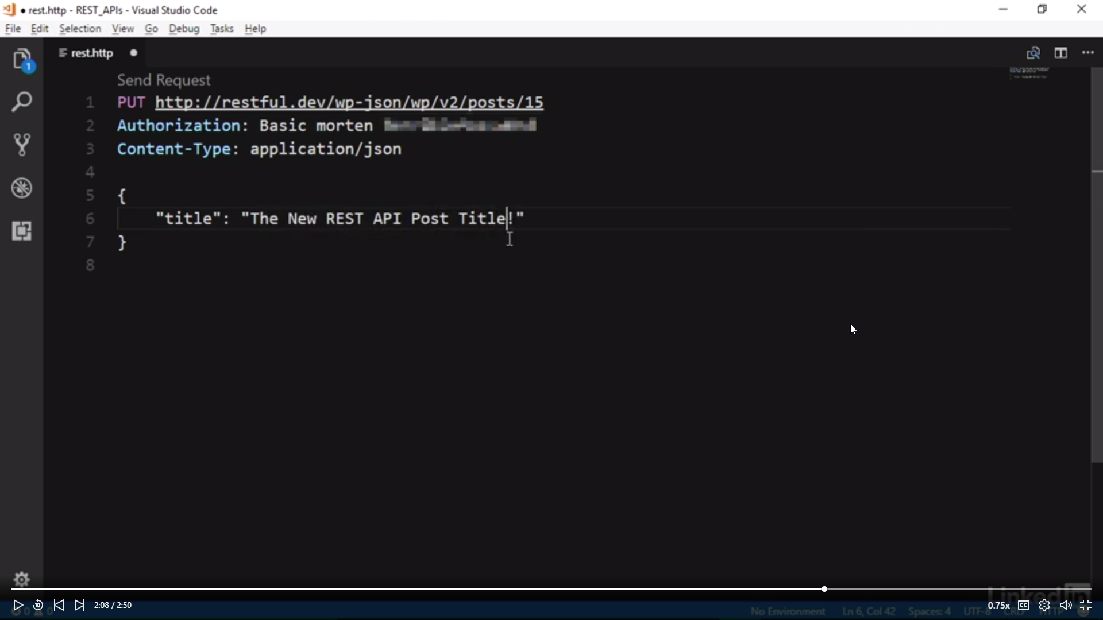
Example of put method against wordpress api

Slide 24
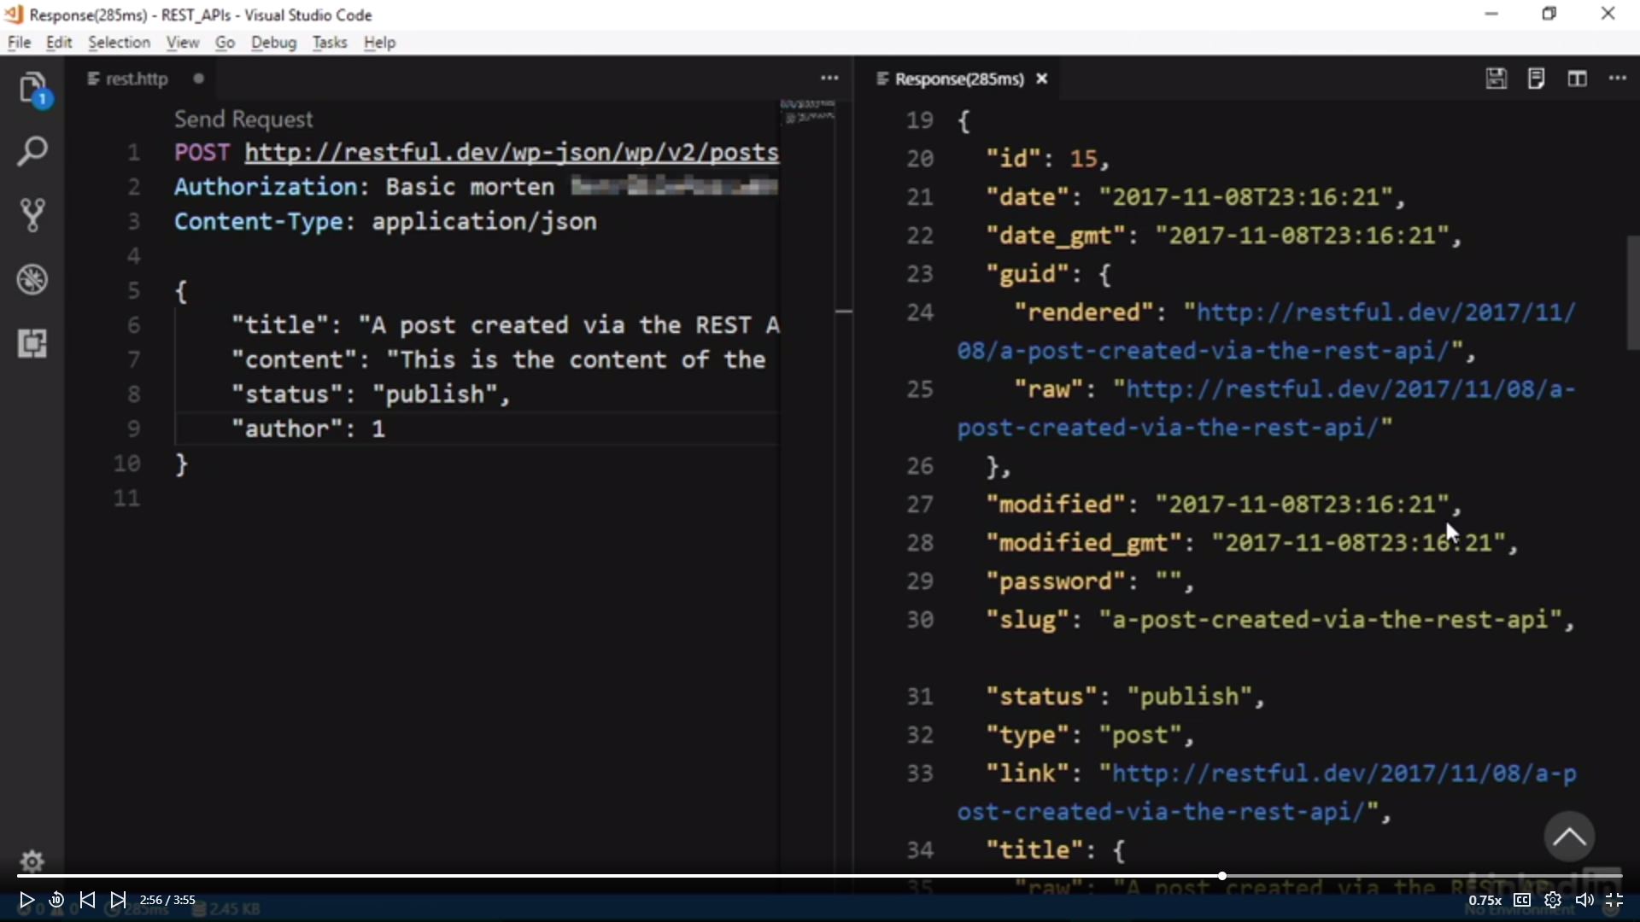
EXAMPLE OF POST METHOD AGAINST WORDPRESS api

Slide 25
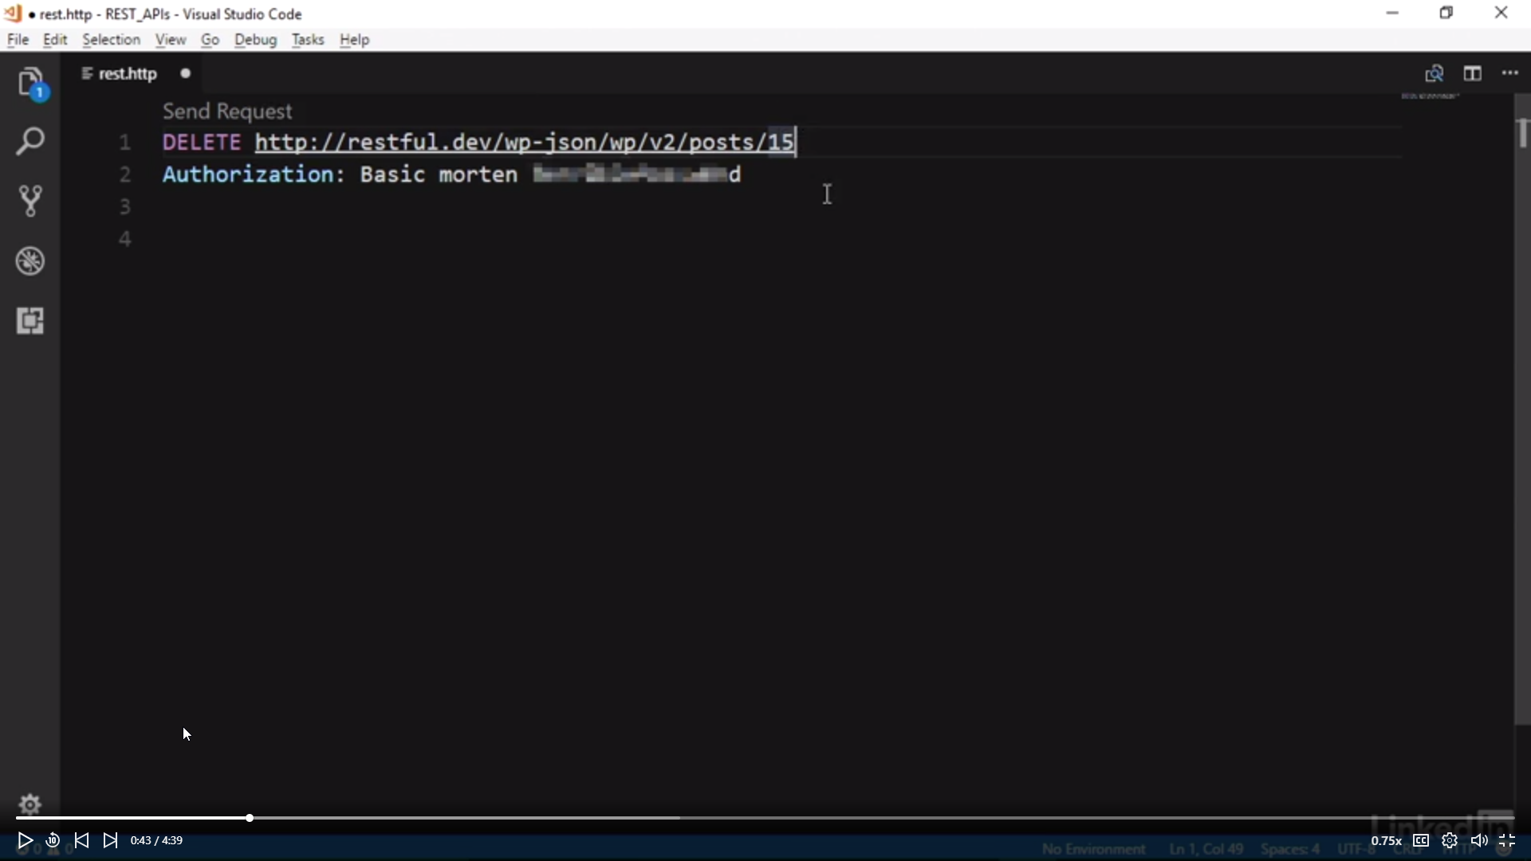
Example of simple delete method (no params) against wordpress api

Slide 26
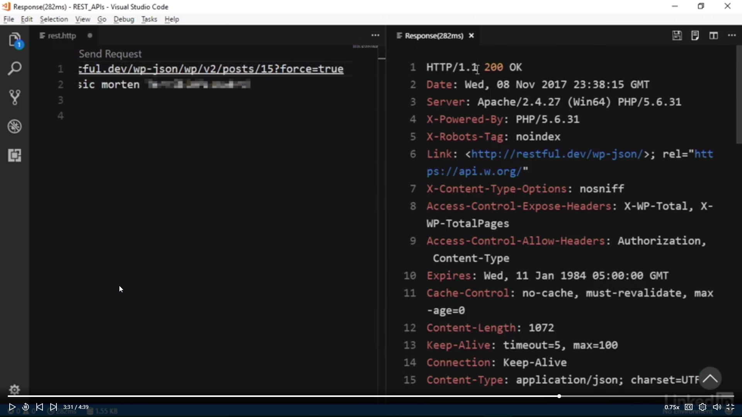
Example of delete with params agains wordpress api

Slide 27
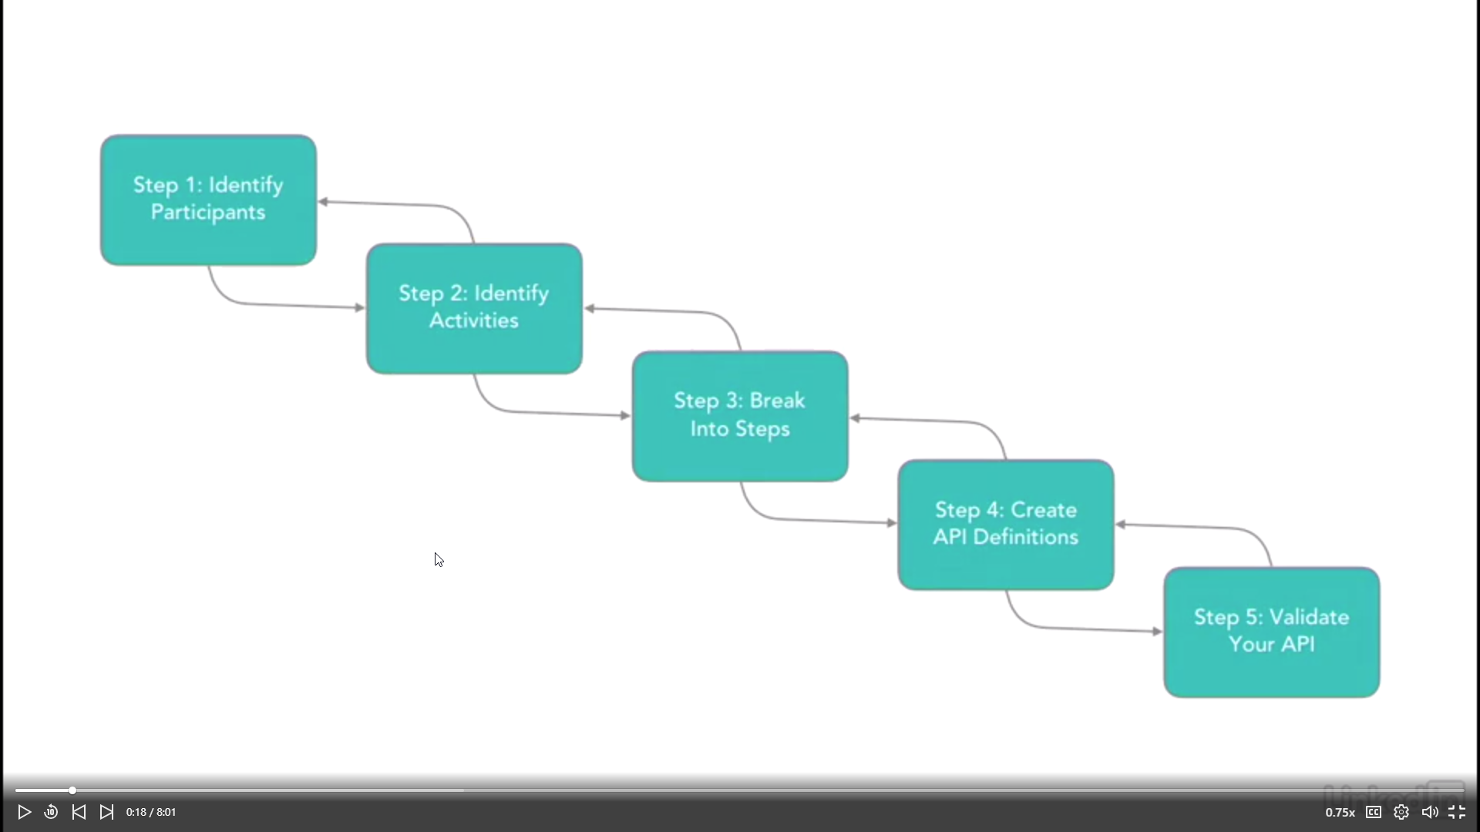
Practical steps to design an api

Slide 28
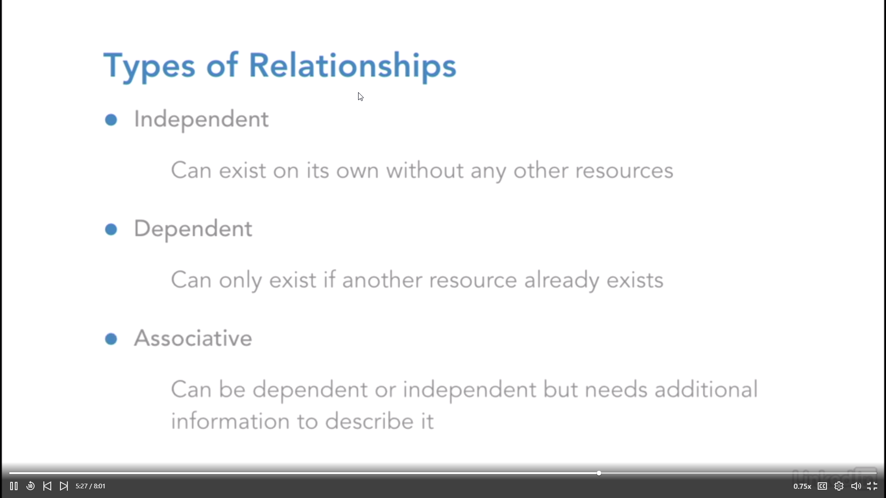
Types of relationships between resources

Slide 29
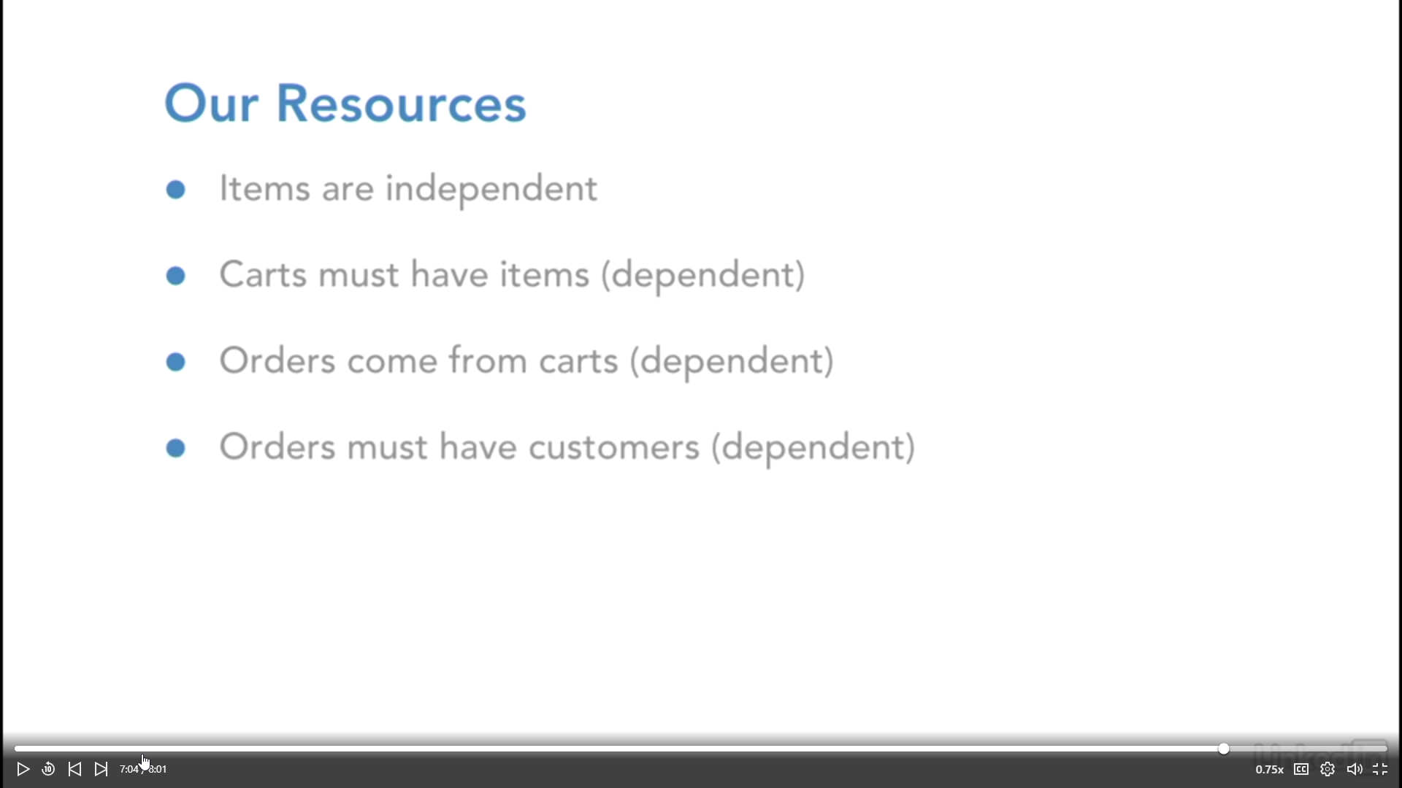
Case study: types of resources in the api

Slide 30
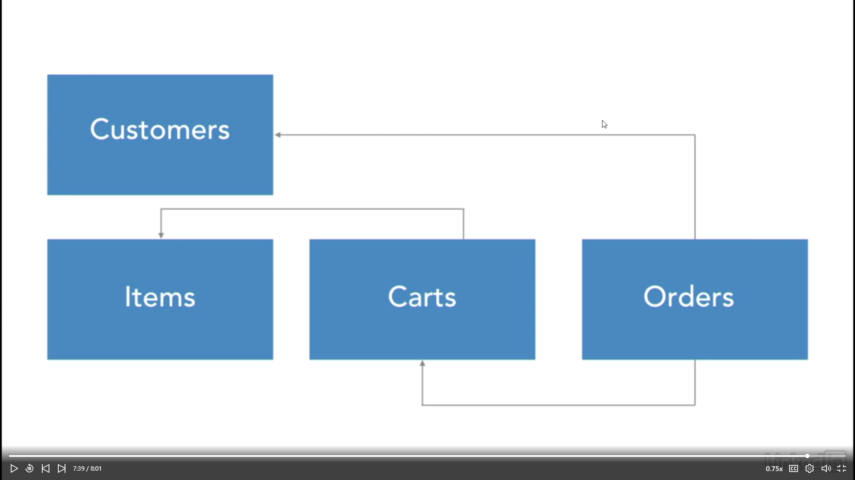
Case study: types of resources in the api

Slide 31
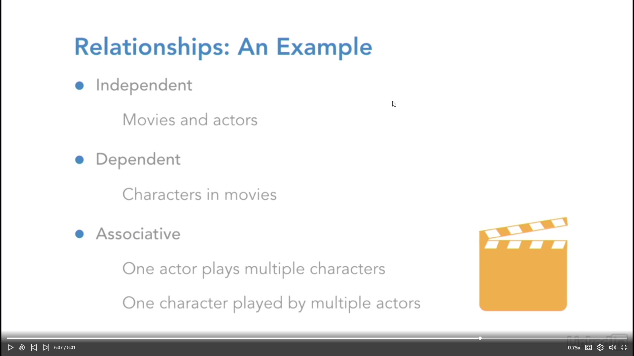
Expressive example relationships between resources

Slide 32
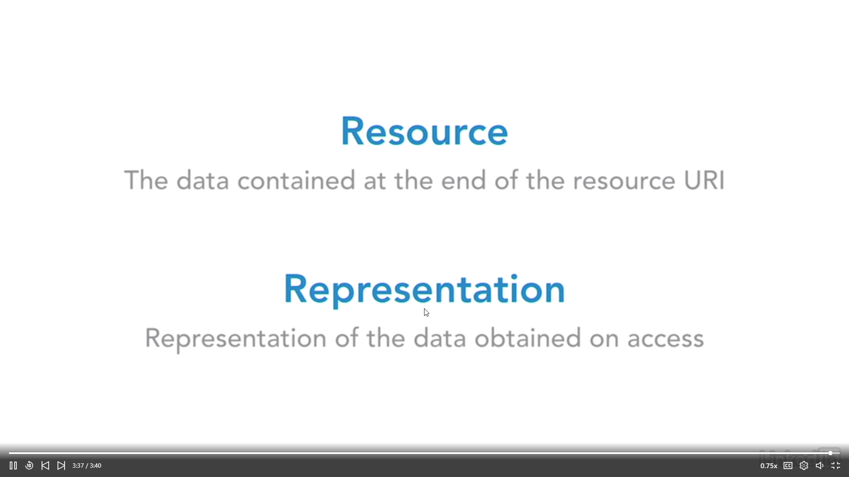
Resources and representation

Slide 33
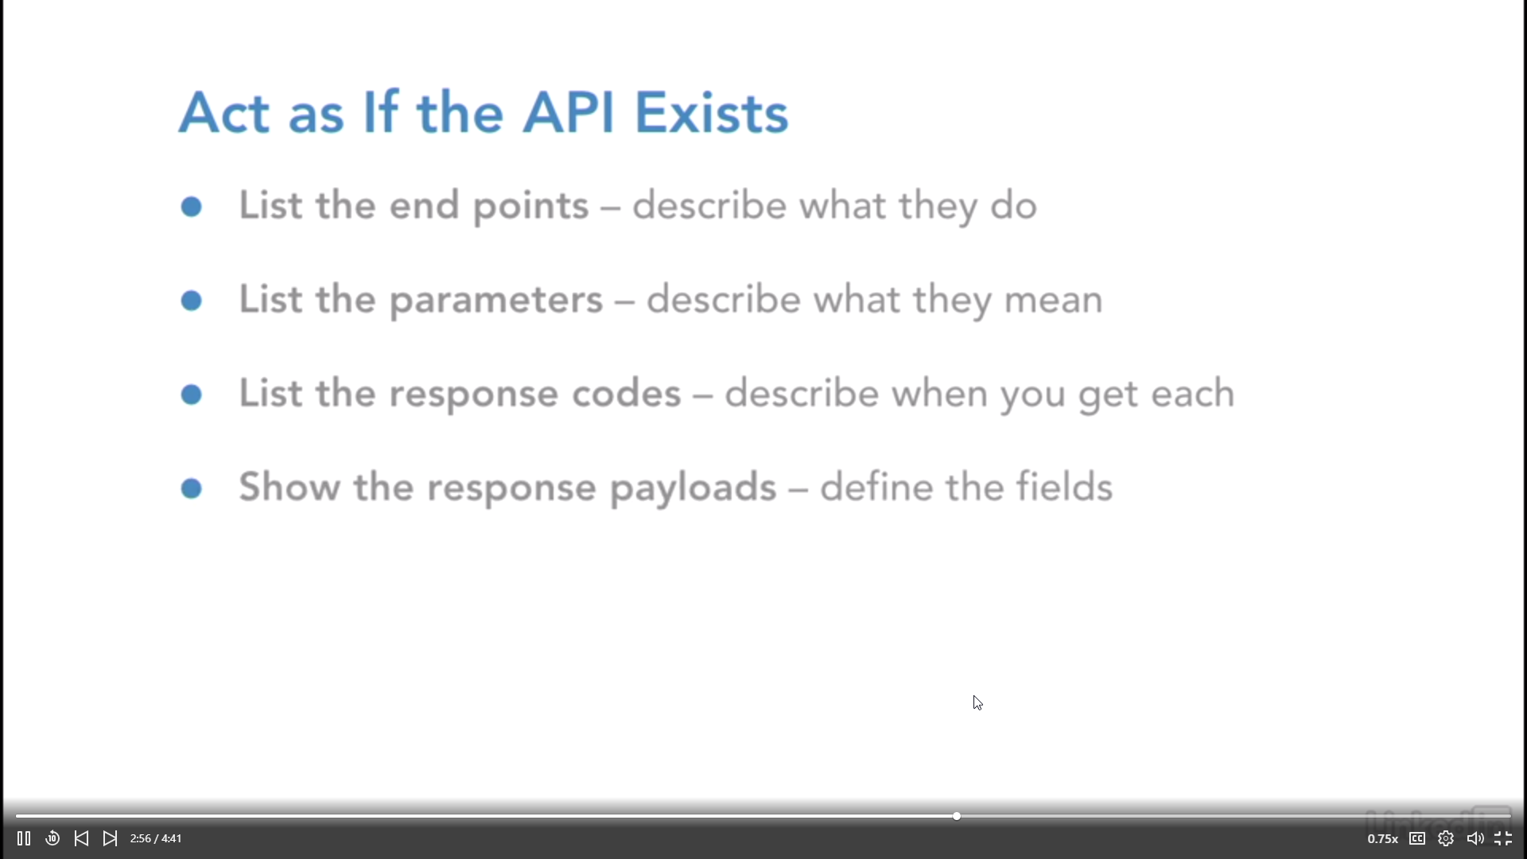
Preparing the documentation of the api

